Slide 1
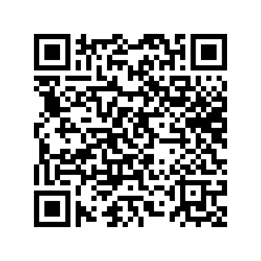

Intro to SQL

Slide 2
summary
What is SQL
Applications
Practical

Slide 3
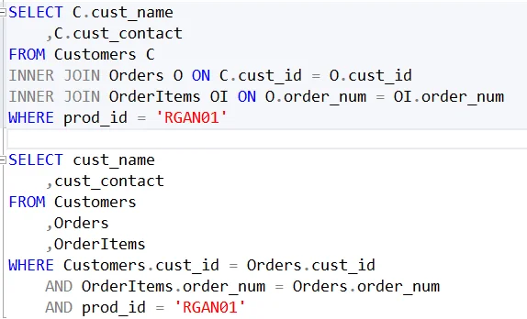

What is SQL?
Structured Query Language
Standard language for storing, manipulating, and retrieving data in relational databases
Extremely common
Many flavors (MySQL, SQL Server, PostgreSQL, etc)
Slight differences

Slide 4



Why use SQL?
Business
Make informed decisions from sales data to customer behavior
Tech & Web
Powering web applications, e-commerce sites, tech platforms
Finance
Analyzing financial data, trends, and market behaviors.
Healthcare
Managing patient data, medical records, and research.
Everyday Apps
From your favorite food delivery app to social media platforms

Slide 5


How do I use sql?

Slide 6
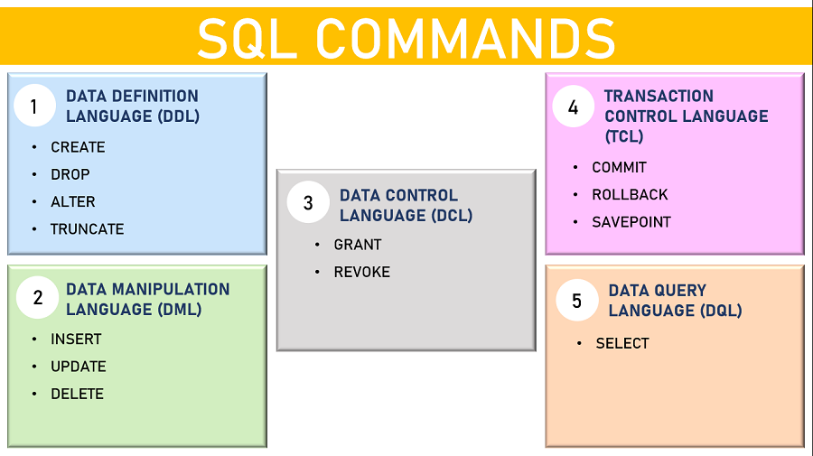
Command Types

Slide 7
Common commands
SELECT: select data from database
FROM: specify table being pulled from
WHERE: filter query to match condition
AS: rename column/table with alias
INNER JOIN/JOIN: combine rows from 2+ tables with matching values
ON: column on which to JOIN the tables
GROUP BY: group data into logical sets
ORDER BY: set order of result (ASC default, DESC reverses order)

Slide 8
AND: combines conditions; all must be met
OR: combines conditions; one must be met
HAVING: same as WHERE, but filters groups
DISTINCT: only SELECTs rows with distinct values of a column
LIMIT: limit rows returned (different in other flavors)
COUNT: count number of rows
SUM: return sum of column
AVG: return average of column

Slide 9
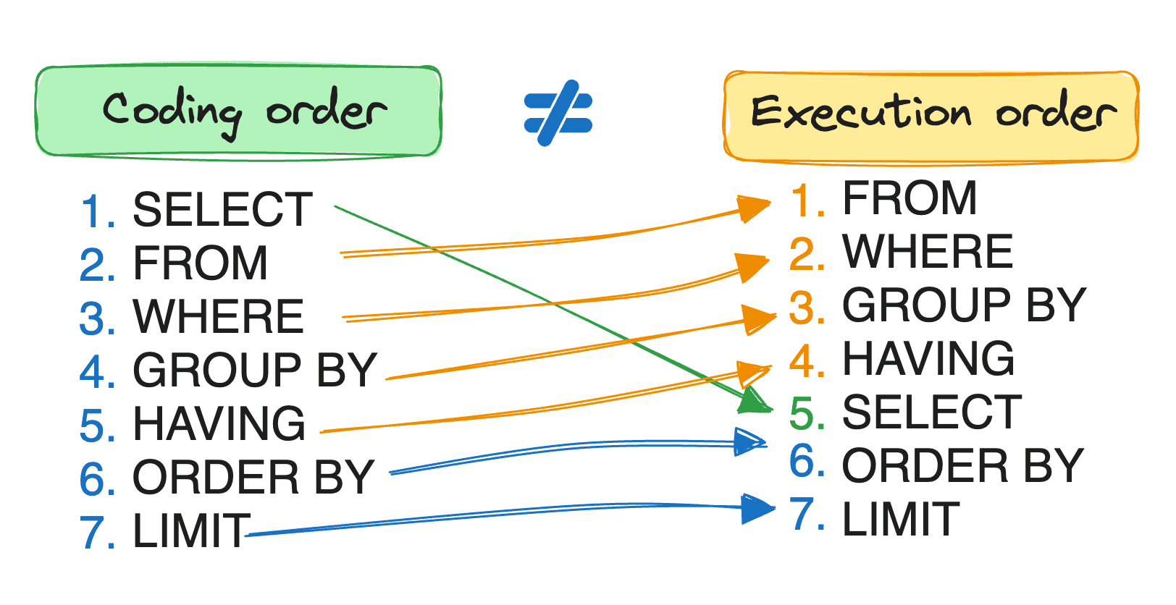

Slide 10
Installing MariaDB
1. Go to https://mariadb.org/ qr code
2. Click download, and then scroll down and click download
3. Follow the wizard instructions
4. Create a password for the root user
5. Open HeidiSQL (is installed alongside MariaDB)

Slide 11
The Database
Go to the Workshop Repository on GitHub
[insert QR code on this slide]/website

